Slide 1

AI strategy & Planning
Max Darby
DARBYM1@TCD.ie

Slide 2
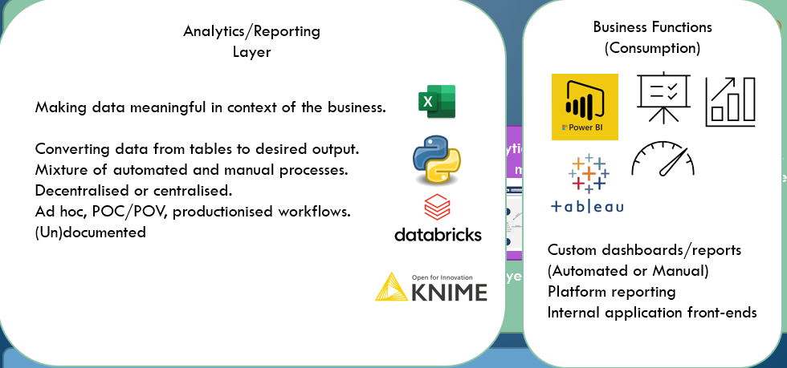
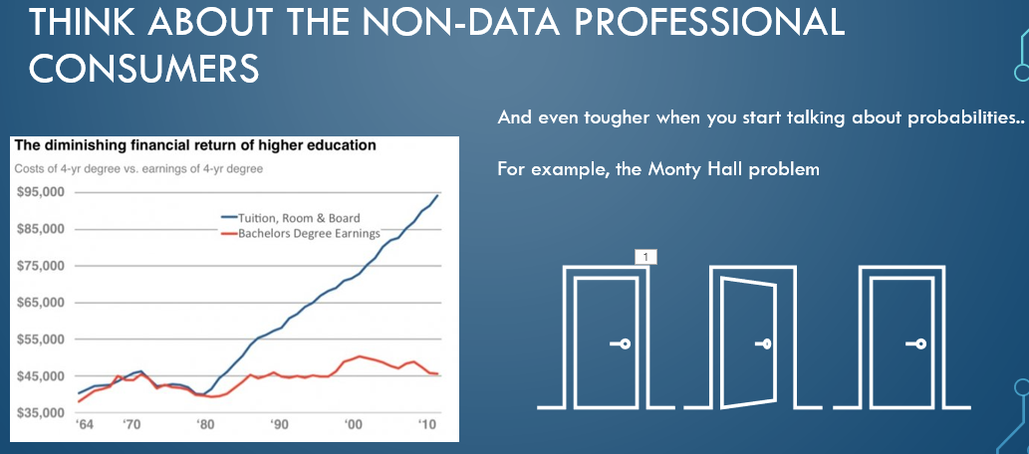
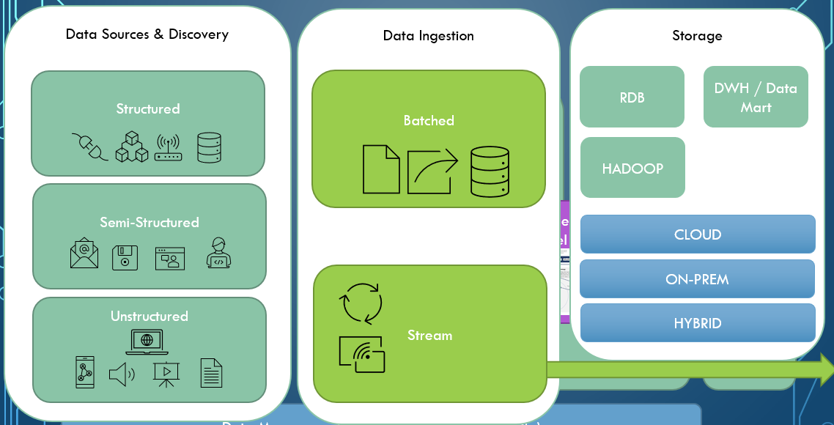
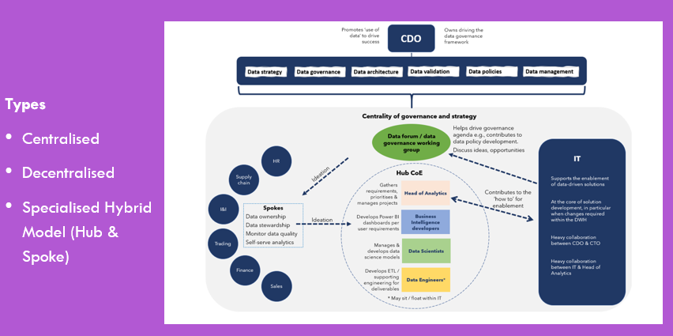
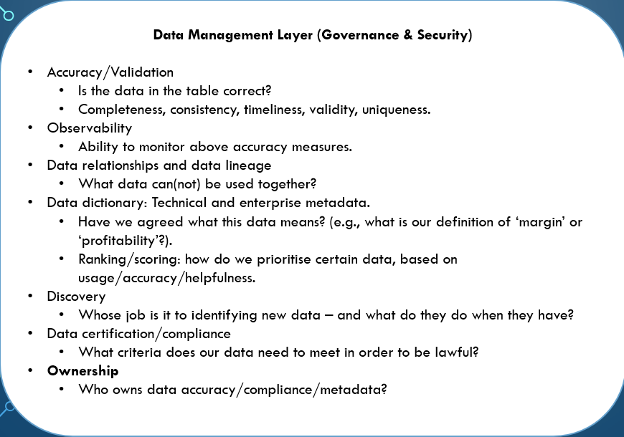
data strategy
Data Sources & Discovery
Data Ingestion
Storage
Analytics/Reporting
Layer
Business Functions (Consumption)
Business Objectives
Data Literacy
Analytic operating model
AI Layer
Data Management Layer (Governance & Security)
Notes:
Business goals/objectives – Decide whether Defensive | Offensive or mix.

Slide 3
Where we left AI last week
“The question of whether machines can think is about as relevant as the question of whether submarines can swim” – Edsger Dijkstra
Bit more fragmented – people aren’t working on general AGI architectures anymore, they are working on specific problems with purpose-built systems (mostly because AI is commercially funded rather than research/state funded now – developments are aligned with commercial goals and targets are more narrow and well-defined).
More brute-brute force than elegant/reductive algorithms that capture the essence of general intelligence
E.g., Transformer based neural net GPT-3 still needs 45TB of data.
Two systems where AI is being built:
KNOWLEDGE: Synthetic intellects: all about knowing everything (huge data sets, different types of data from the web and computer networks)
ROBOTS: ‘Forged laborers’ (Kaplan) or Disembodied AI: more like ‘smart environments’. Sensors and actuators everywhere (actuator could be you – e.g., driving with Google Maps).
Notes:
Humans Need Not Apply – Jerry Kaplan

Slide 4
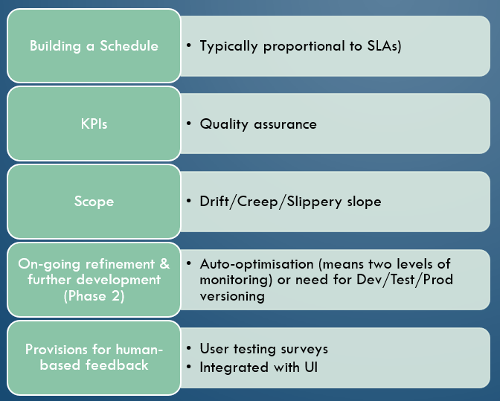
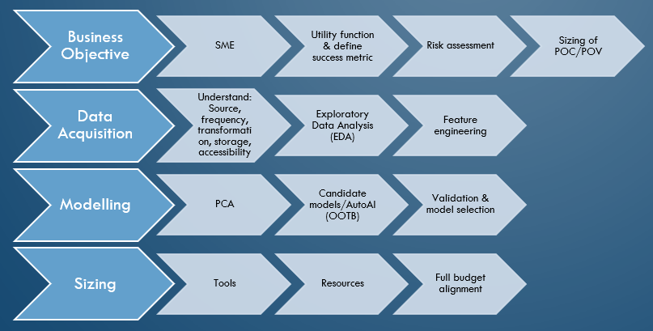
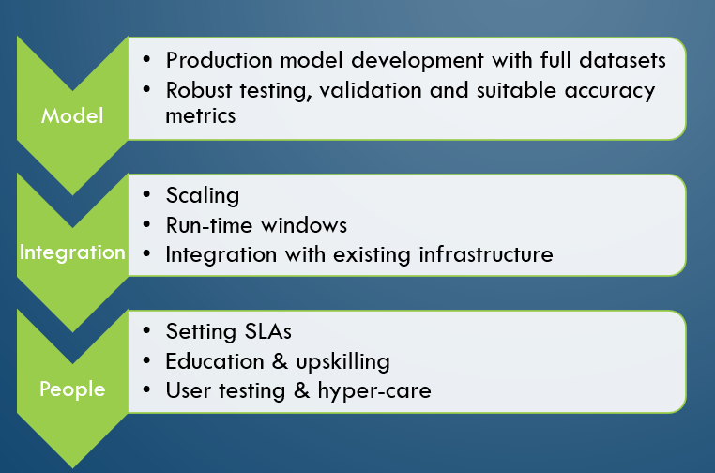
This week: AI Development/Strategy
STAGE 1: DEVELOPMENT
STAGE 2: DEPLOYMENT
STAGE 3: MAINTENANCE
Note: this is a strategy, not an over-simplified development cycle like is usually shows for AI dev (i.e., get data, build model, test, validate, deploy – there is so much more to address, and it isn’t necessarily circular – it’s usually a waterfall).

Slide 5
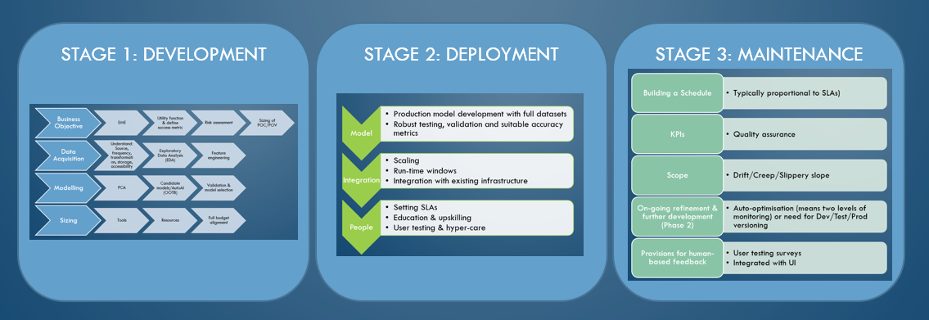
Stage 1: Development
Business Objective
Subject Matter Expert
Utility function & define success metric
Risk assessment
Sizing of POC/POV
Data Acquisition
Understand: Source, frequency, transformation, storage, accessibility
Exploratory Data Analysis (EDA)
Feature engineering
Modelling
Principle Component Analysis
Candidate models/AutoAI out-of-the-box (OOTB)
Validation & model selection
Sizing
Resources
Full budget alignment
Tools
Worth thinking about at this stage:
Proof Of Concept vs. Proof Of Value
Documentation
Auditing
Reproduction
Maintenance
Winning hearts & minds
Communicate stages in clear language & manage expectations
Potential for discovering nested projects

Slide 6

Nested Projects

Slide 7
Exiting Stage 1: GO or No Go What if it turns out the problem isn’t modellable?
Potential causes could be imbalanced or insufficient data. Complex/interdependent processes. E.g., a pandemic with no/limited data – how to make the best decisions?
You can still use AI but in a data-informed way.
‘AI-based human-centric decision support framework’
Centres around a Subject Matter Expert
Symbolic ‘asset knowledge’ system (if, then).
Constraint computing around business rules.
Significant provisions for human-machine feedback.
Notes:
https://link.springer.com/article/10.1007/s10479-021-04373-w

Slide 8
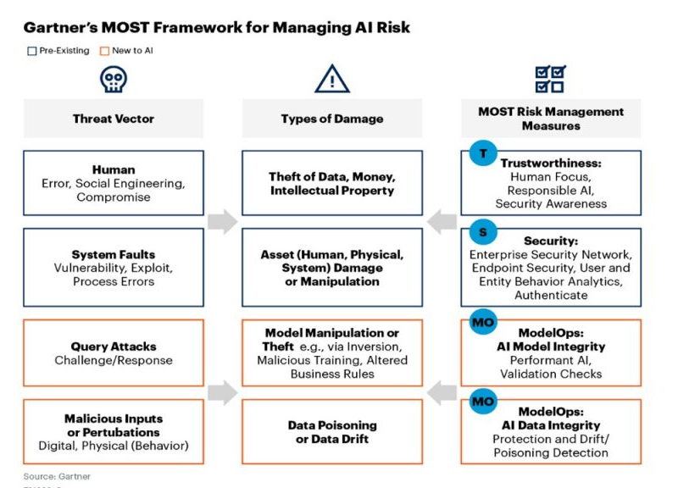
Stage 1: Methods and tools
Defining business objectives
Null hypothesis testing
Design Thinking (user-centric)
Documentation and Flowcharts
Word & PowerPoint
Visio/X-Mind/LucidChart
Exploration
Jupyter notebook + Matplot
Python: DataPrep, Pandas-profiling, Sweetviz, Lux, D-Tale
Data visualisation tools: PowerBi/Tableau
AI risk frameworks
US: National Institute for Standards and Technology
EU: European Commission
Gartner, etc
Notes:
https://blogs.gartner.com/avivah-litan/2021/01/21/top-5-priorities-for-managing-ai-risk-within-gartners-most-framework/

Slide 9
Stage 2: Deployment
Model
Robust testing, validation and suitable accuracy metrics
Integration
Integration with existing infrastructure
People
Education & upskilling
User testing & hyper-care
Production model development with full datasets
Scaling
Run-time windows
Setting Service Level Agreements (SLA)
Batch vs Model Serving (API)
Worth thinking about at this stage:
Ownership
Scope & definitions
Intellectual Property
Tools
Usually dictated by IT/company existing infrastructure.

Slide 10
Stage 3: Maintenance
Building a Schedule
KPIs
Scope
On-going refinement & further development (Phase 2)
Auto-optimisation (means two levels of monitoring) or need for Dev/Test/Prod versioning
Provisions for human-based feedback
Typically proportional to SLAs
Quality assurance
Drift/Creep/Slippery slope
User testing surveys
Integrated with User Interface
Output being used in another model
Governance
Transparency/XAI
Bias/Fairness
Responsibility and Liability
Lineage
Control
Privacy
Autonomy/’opt-out’-ability
Compliance
Notes:
‘A Citizen’s Guide to Artificial Intelligence’ John Zerilli

Slide 11
Assignment 2: Individual project
60%
Elevator pitch 2 min presentation (20%) & written submission (40%)

Slide 12
You will need to develop an AI proof-of-concept project plan by yourself, based on the company for which you developed a data strategy in your group assignment.
You will present a concise overview of your plan to the class during the final lecture. You will need to describe how you evaluated the business objective, and why you selected the AI model you chose, as well as any other workflow, data, personnel needs you have planned for.
Individual presentations need to be prepared and delivered in Session 6. Each student has 2 minutes to present the case in the Pecha Kucha style of presenting (6 slides that automatically advance every 20 seconds).
Your written submission will be due to be submitted shortly after presentations.
The individual assignment will be assessed in terms of:
1. Demonstrate understanding of the business need and appropriate choice of AI solution.
2. The clearness and details of description of the proof-of-concept, addressing (but not limited to) business needs, source data, model selection, architecture and development pipeline, model evaluation & on-going maintenance, required personnel, anticipated challenges, ethics/GDPR considerations.
3. The cohesiveness of oral presentation and the organization and clarity of presentation slides.

Slide 13
A note on Grading

